Slide 1


Profiling Electricians to Improve Public Safety
Data Science Project – Part 2
Group 9

Slide 2
Our Team
Supervised By:
Chunhua Liu
Team Members:
Chen Zhou
Meghna Panda
Vignesh Lakshminarayanan
Xinyu Mao
Client:
Priya Laxman

Slide 3

Our Client.
Safety regulator for electricity, gas and pipelines.
Facilitate results with:
Safety
Designing
Communicating safety criteria’s efficiently
Managing licensing and registration
Approve procedures

Slide 4
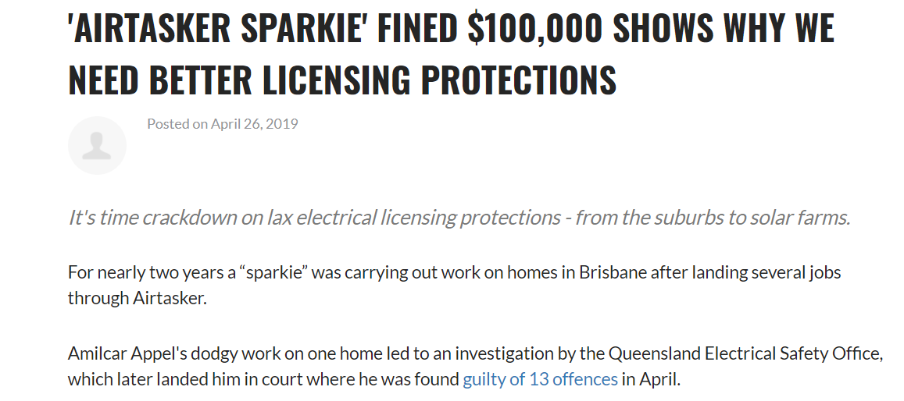
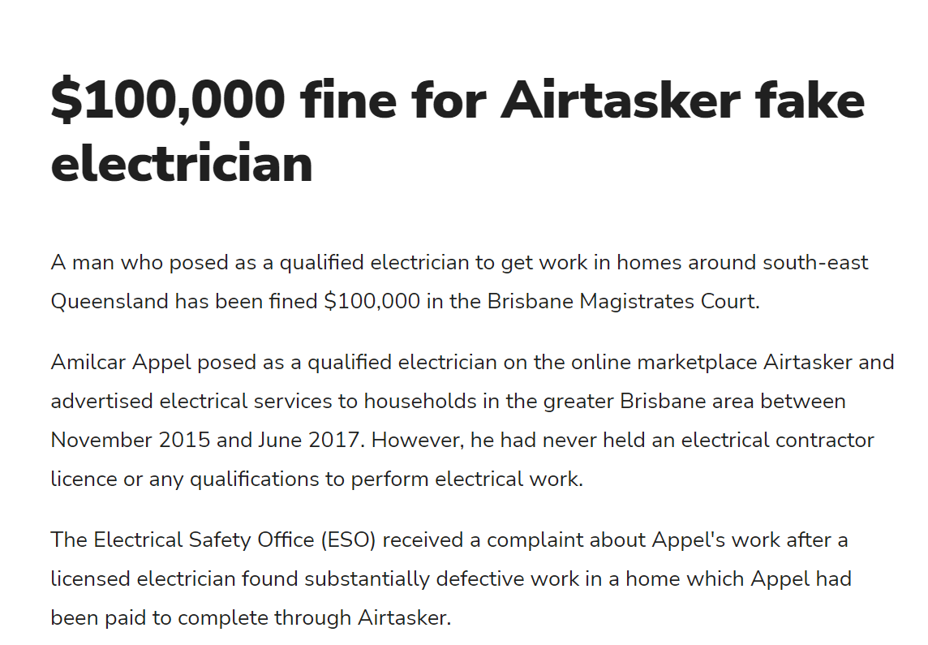
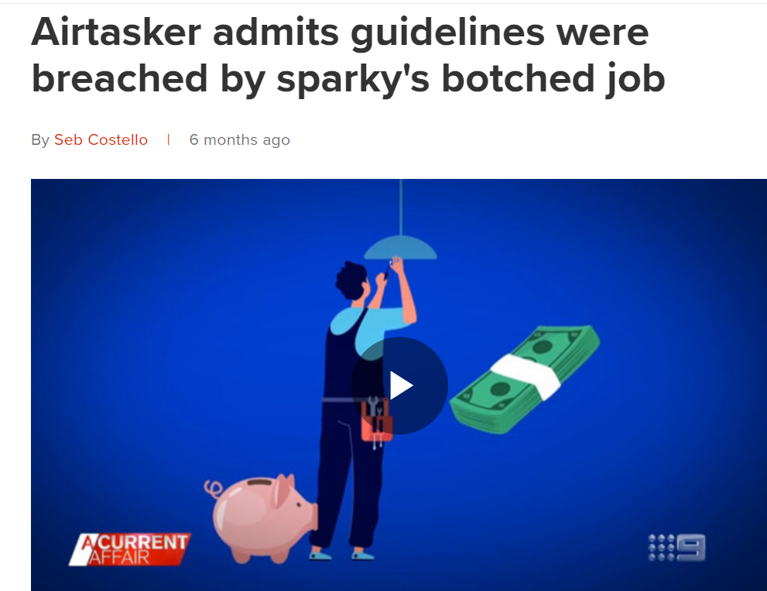
Why it’s a serious threat?

Slide 5
Client Problem
Over the several years statistics show that Online jobs platform such as Airtasker has admitted to its community guidelines being breached in relation to an unlicensed electrician accepting electrical work.
This is putting the workers themselves and the public at risk as well as requiring re-working on the job to ensure the safety standards.
Australia's Competition and Consumer Commission (ACCC) has previously flagged the need for a "Digital Platforms Ombudsman" to regulate companies like Airtasker, Uber and Gumtree.
The main challenge for the client (ESV) is to identify all the unlicensed electricians who are carrying out electrical work in online platforms like Airtasker, Gumtree.

Slide 6
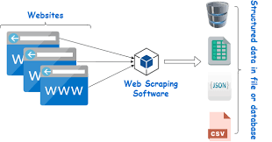

Main Objectives
Explore the profiles of electricians/handymen on 4 different websites.
Check whether they have their license, if so check whether they already exist in the ESV dataset or not.
Using web scrapping, text analysis and machine learning algorithms to extract, process the data and present data visualisation.

Slide 7
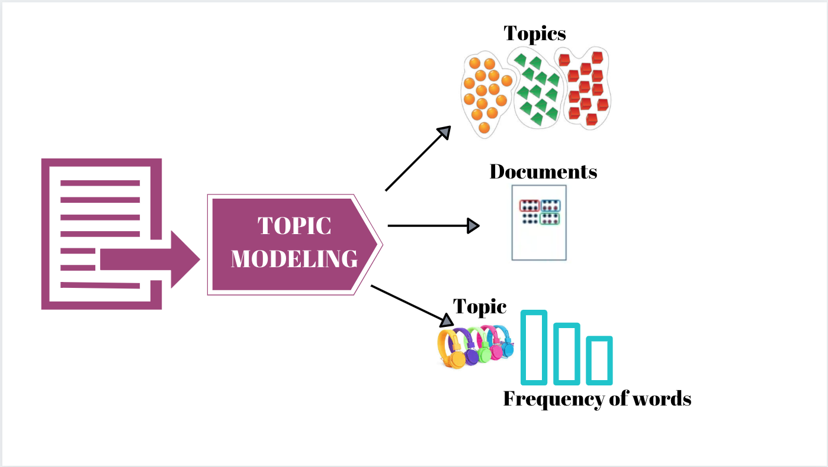




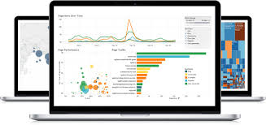



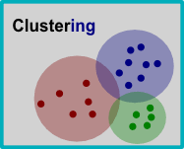
Project Pipeline
Phase 01
Phase 02
Phase 03
Phase 04
Data Collecting
Data Processing
Data Analysis
Visualization
Exploring four websites to crawl and scrap worker data.
Cleaned out filtered data. Classified the data accordingly for analysis.
Applied clustering and modeling approaches to get desired results
All results summed up into a tableau story.

Slide 8


Crawling Websites
4 Platforms:
Tasks Search – 3470 Tasks
1. Login Status
Airtasker
2. Location Options:
3. Keywords:
['electrician', 'electric', 'electronic']
Gumtree
Melbourne VIC
Bendigo VIC
Warrnambool VIC
Traralgon VIC
Geelong VIC
Horsham VIC
Shepparton VIC
Workers’ URLs Extract – 767 Workers
Task Status → Classification
Service Seeking
Open → tracked & updated
Assigned
Completed
Expired
Cancelled
HiPages
Closed → extracted directly

Slide 9
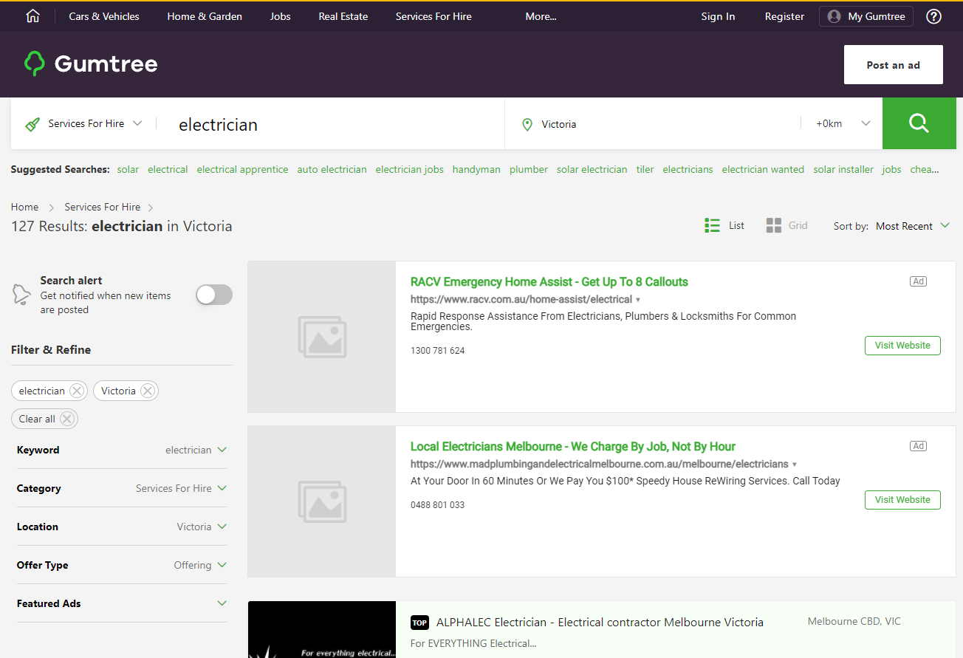
Crawling Websites
151 Companies
4 Platforms:
Airtasker
Gumtree
Service Seeking
HiPages

Slide 10
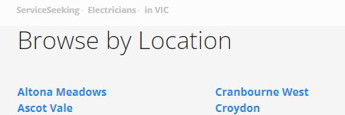
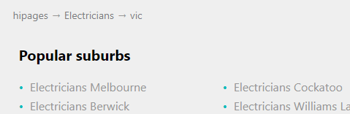
Crawling Websites
4 Platforms:
Airtasker
Require Suburbs in Victoria →
Use Suburbs List Recommended by Each Website
Gumtree
Service Seeking
101 Suburbs in ServiceSeeking
1000 Suburbs in HiPages
392 Companies
643 Companies
HiPages

Slide 11
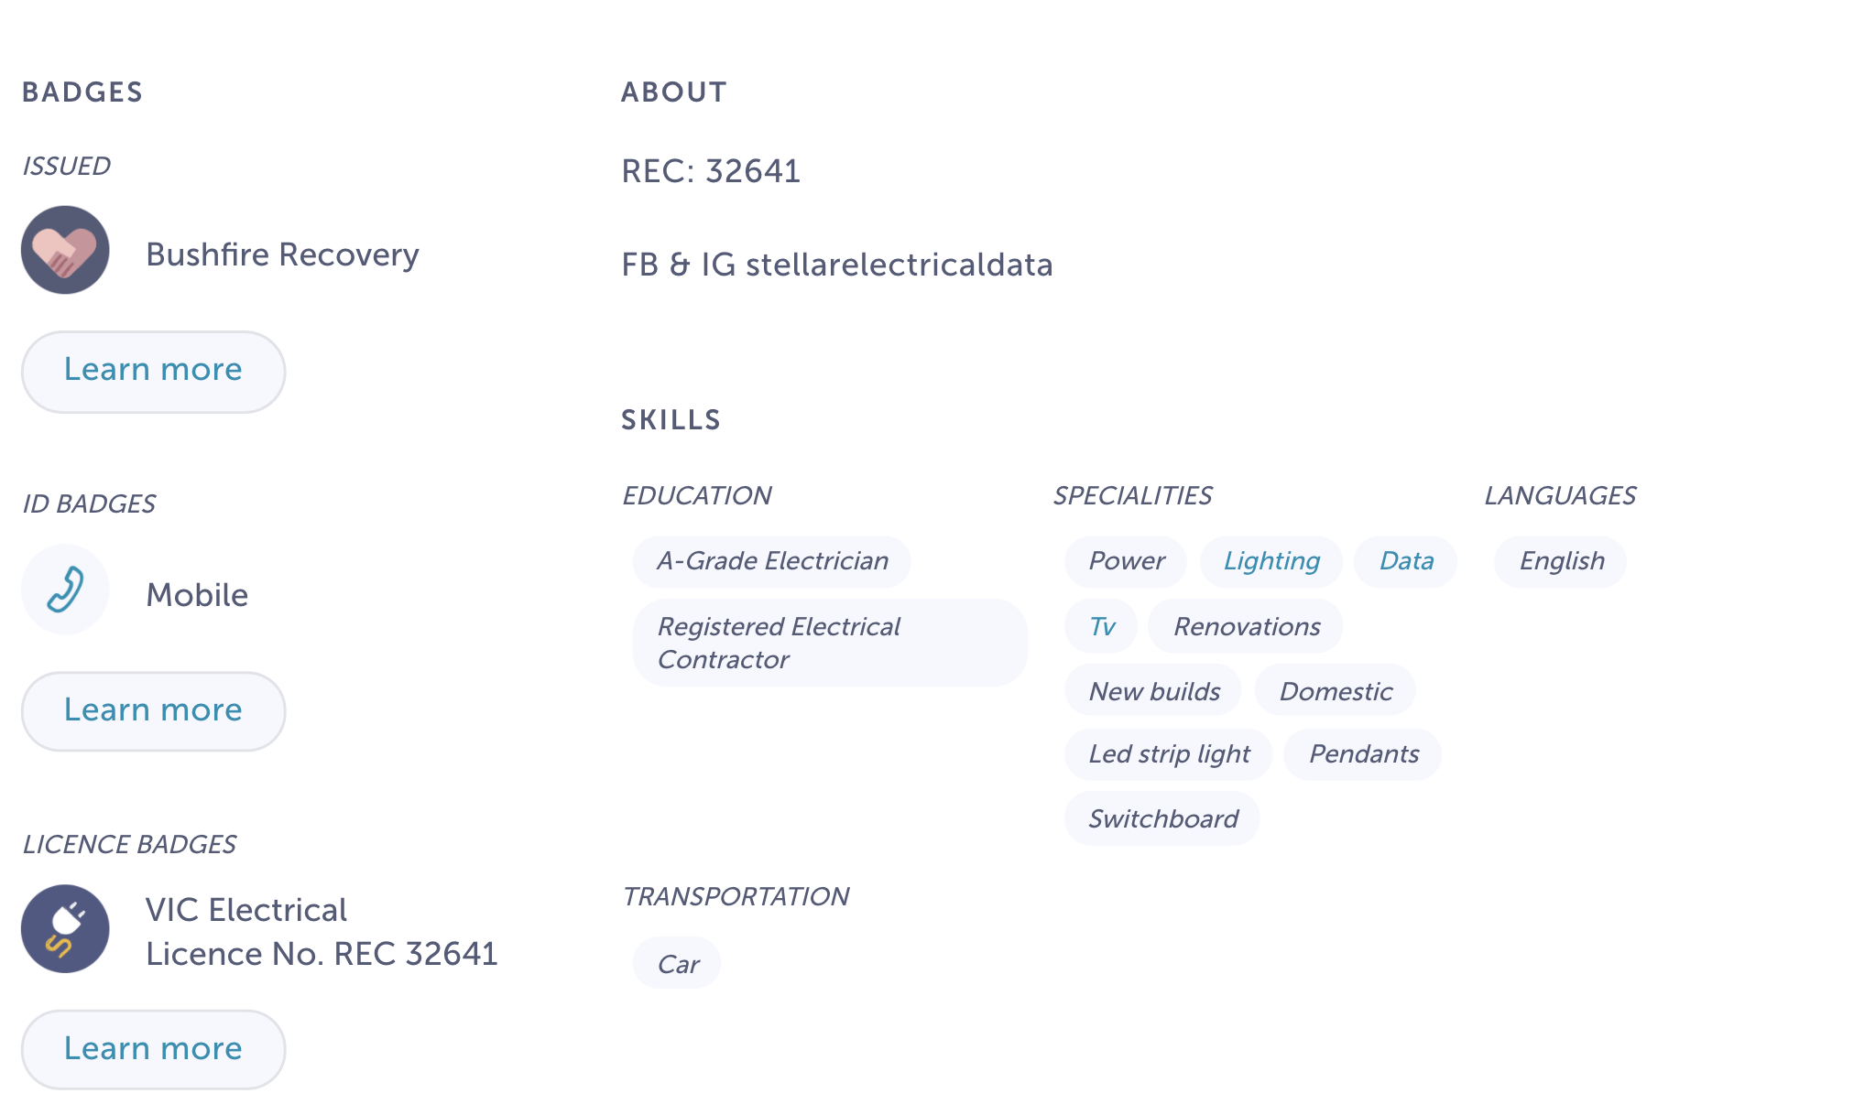
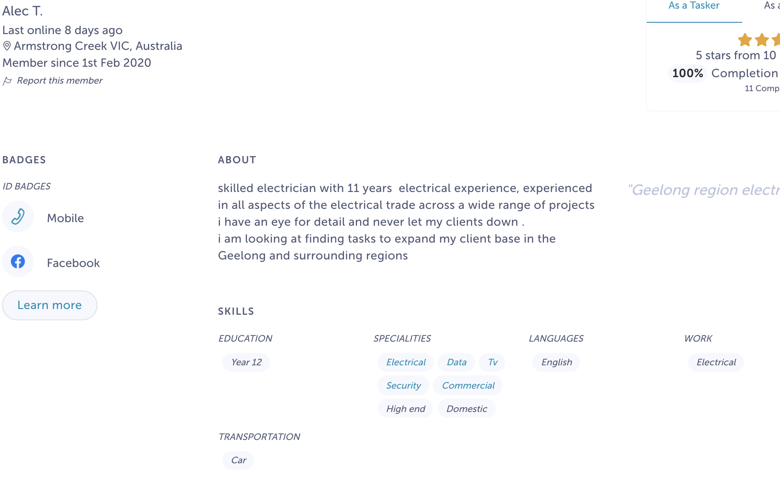
Scrapping and Classification
All electrician data was scrapped from 4 different websites. The scrapped data was divided into three parts.
Licensed Electricians
Electricians, License number not Provided
https://www.airtasker.com/users/lachlan-b-4132247/
https://www.airtasker.com/users/alec-t-18429333/

Slide 12

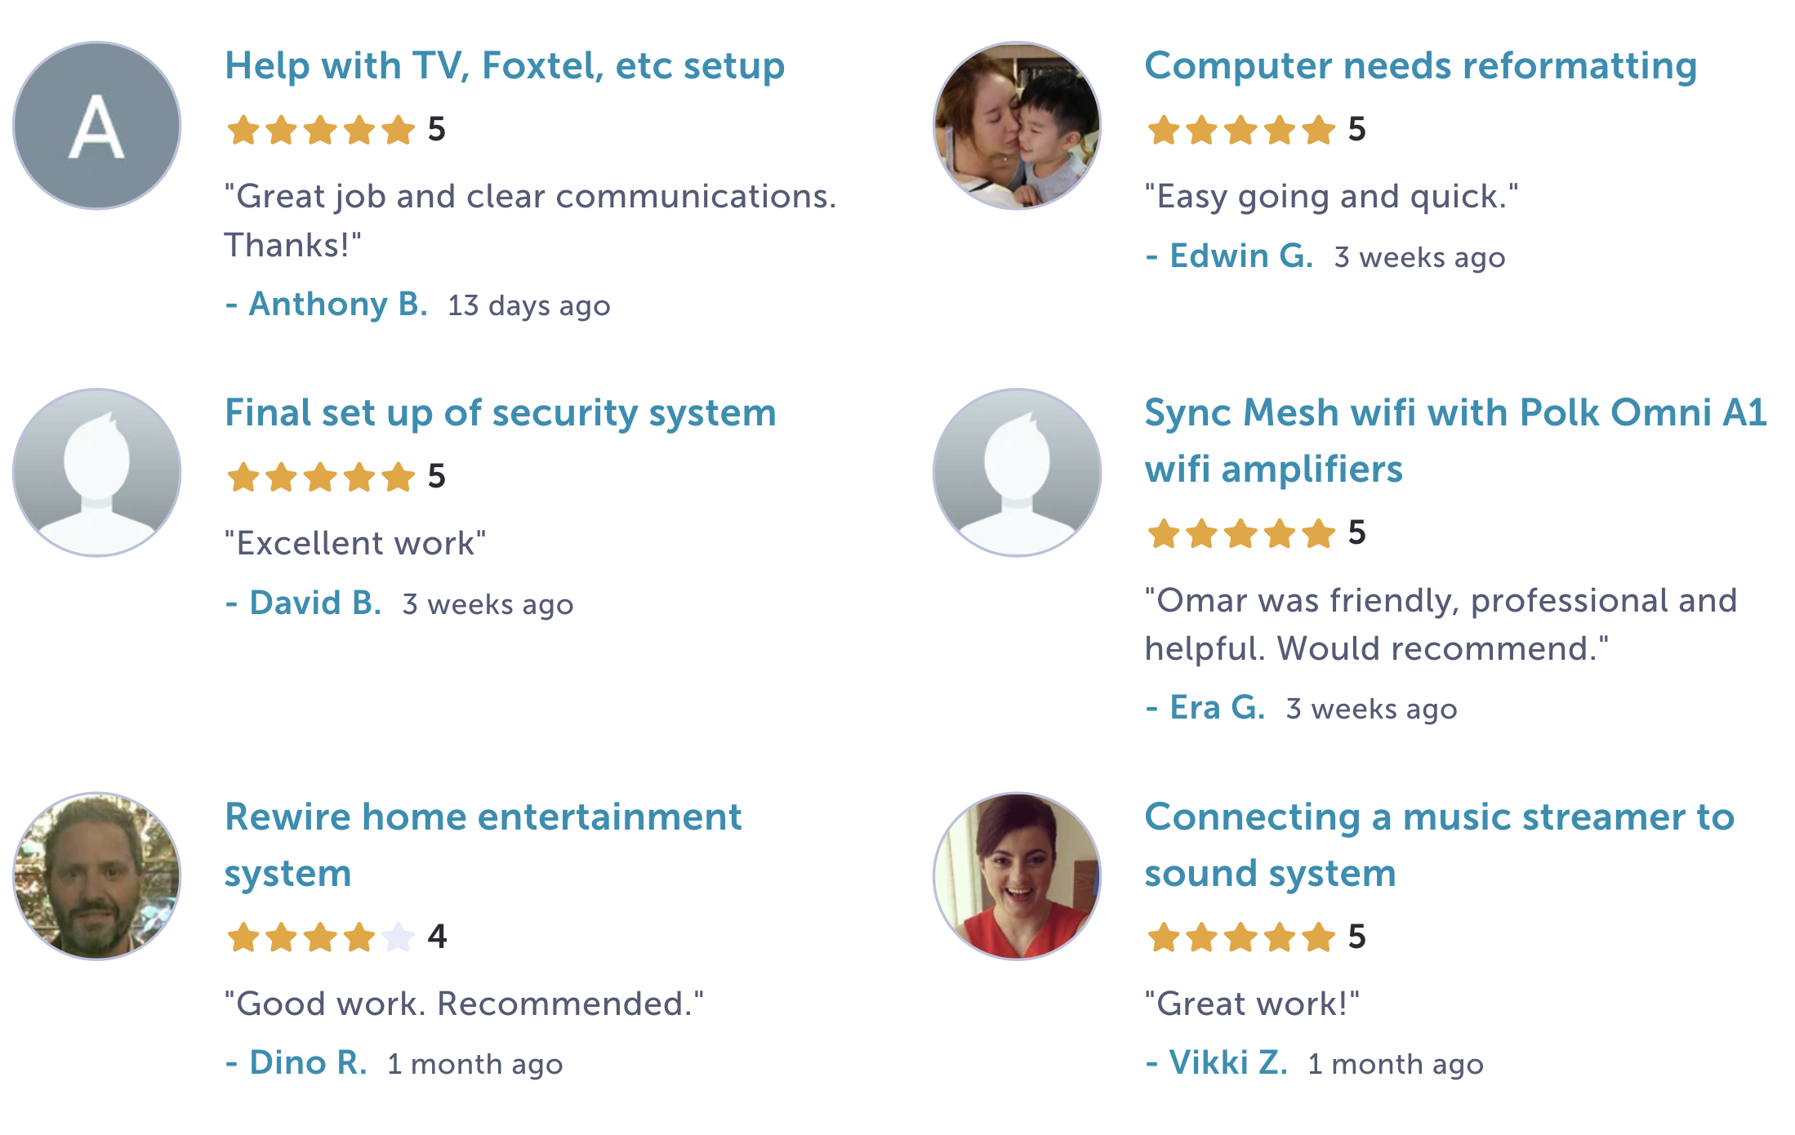
Not electricians, but performed electric task
https://www.airtasker.com/users/muhammad-omar-m-9221041/

Slide 13
Statistics
Common Features
Summary
License Information | Website
 | Airtasker | Gumtree | HiPages | Service Seek | Total
Electrician - License Number not provided | 232 | 67 |  | 176 | 475
Licensed Electrician | 85 | 32 | 599 | 171 | 887
Not electrician, but performed electric task | 448 | 16 |  |  | 464
Total | 765 | 115 | 599 | 347 | 1827
Name
Address
Suburb
Postcode
License Information
Description
Ratings
Reviews
Timeframe

Slide 14
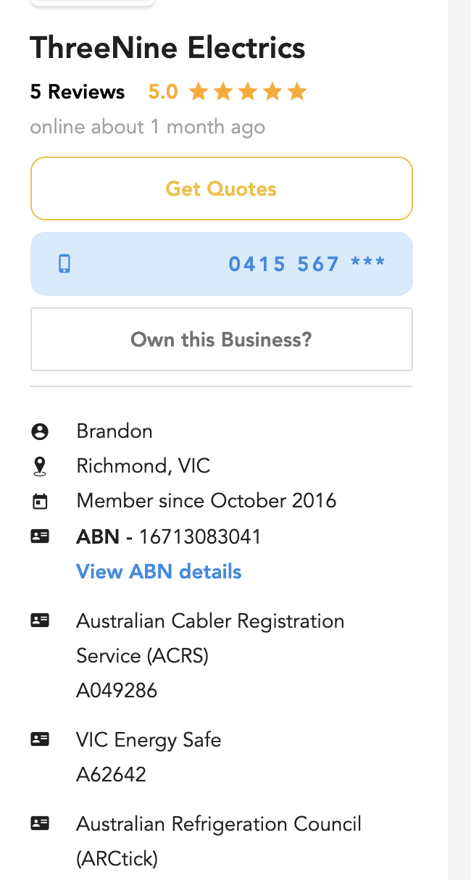
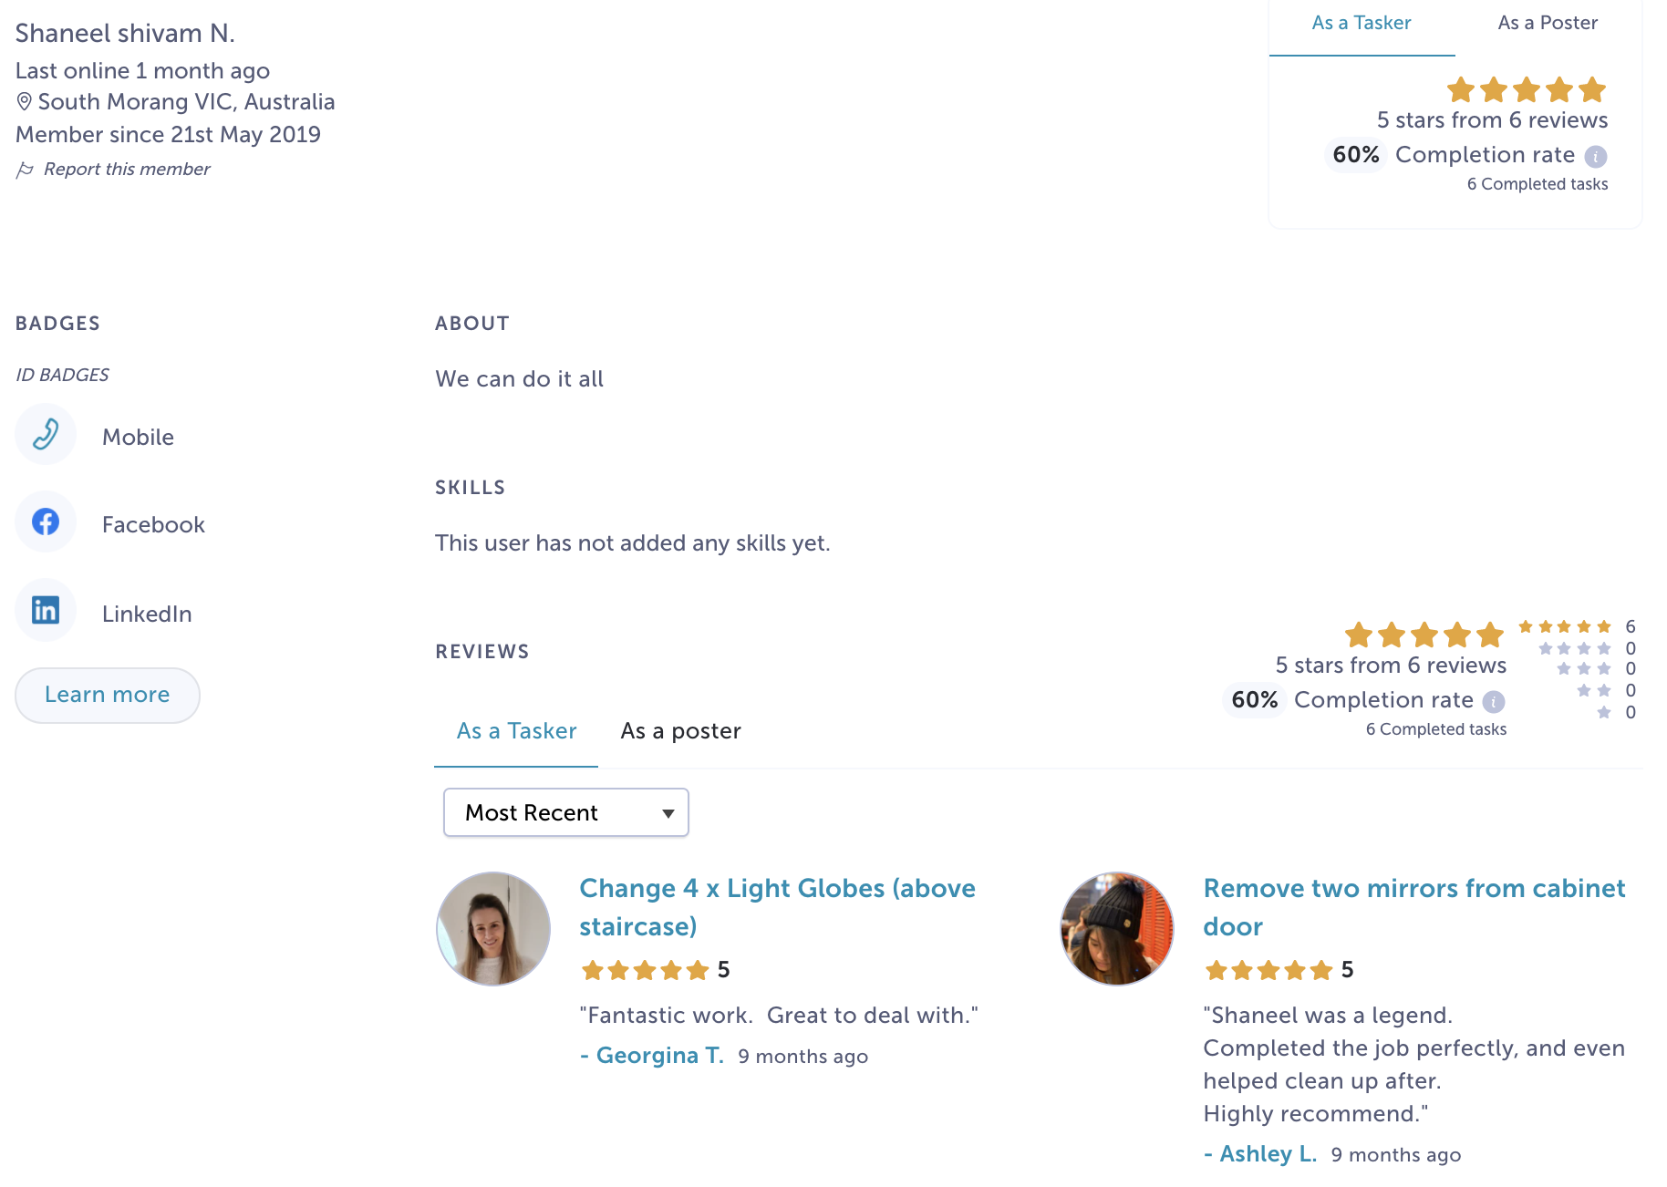
Data Processing
Blank Descriptions
License Numbers
Duplicate Entries
https://www.airtasker.com/users/shaneel-shivam-n-15382209/
https://www.serviceseeking.com.au/profile/137946-threenine-electrics?source=

Slide 15
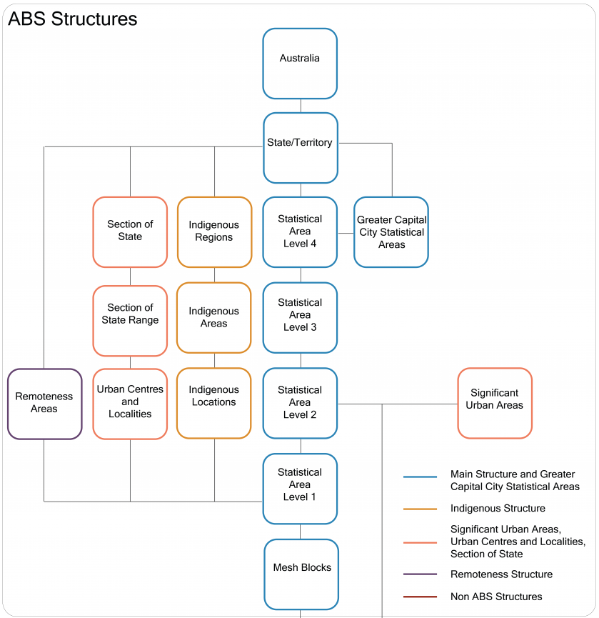
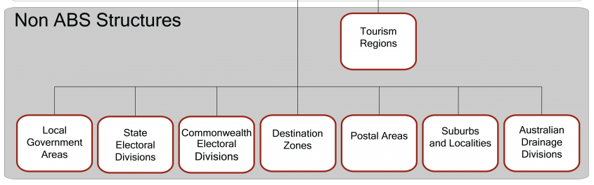
Results – Worker Information
Storyline of ESV project: https://public.tableau.com/shared/QJJFHF68Z?:display_count=n&:origin=viz_share_link

Slide 16
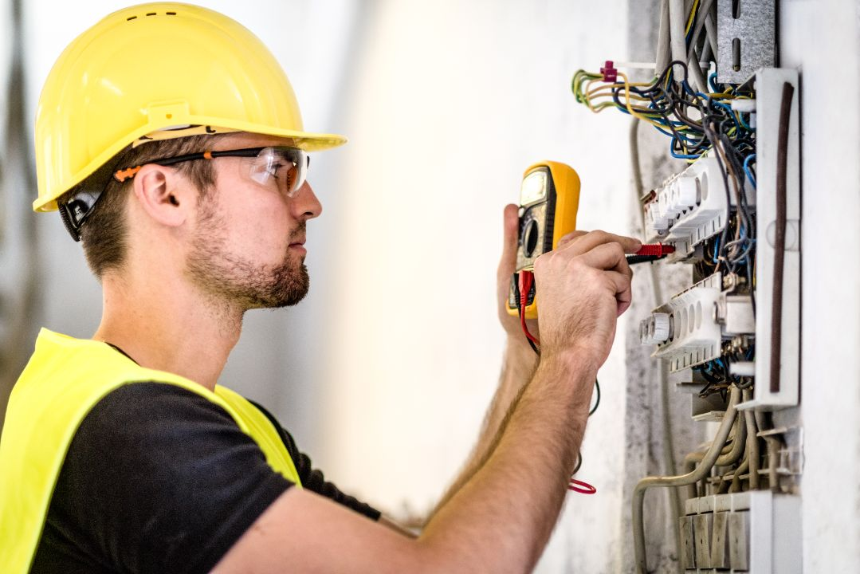
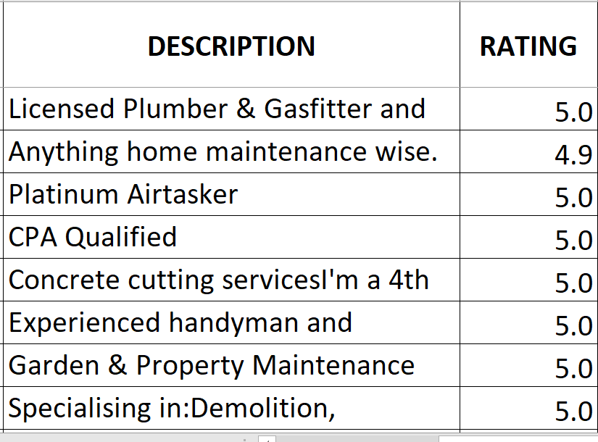


Why Topic Modelling?

Slide 17
Latent Dirichlet Allocation (LDA)
LDA is one of the most popular methods in topic modeling used in Natural Language Processing (NLP).
LDA is an unsupervised generative probabilistic model of a corpus.
The basic idea is that the documents are represented as random mixtures over latent topics, where a topic is characterized by a distribution over words.
LDA represents topics by word probabilities.
The words with highest probabilities in each topic usually give a good idea of what the topic is can word probabilities from LDA.

Slide 18
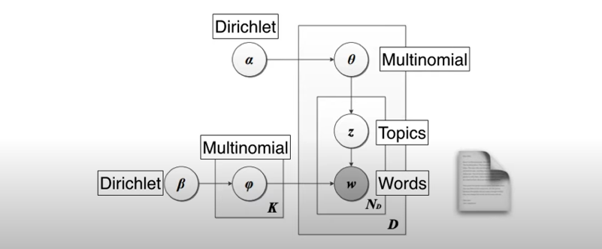
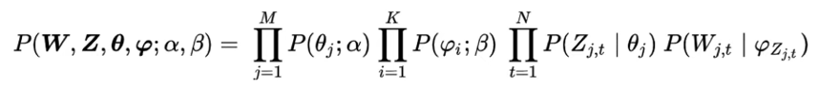
Representation of LDA using probabilistic graphical model

Slide 19
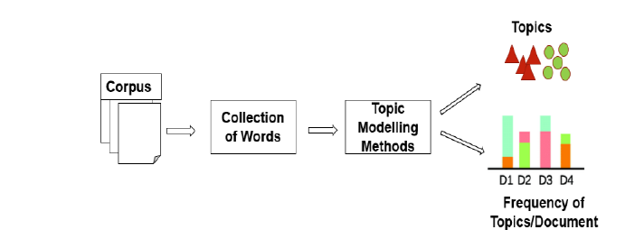
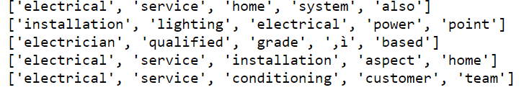
Methodology
Dataset
Pre-Processing of data
Build Topic Modelling using LDA
Computing Coherence Score
Visualization of Results

Slide 20
Task analysis within the LDA model
Analysis with multiple LDA model in 4 dominant topics
Visualize the analysis result using these 3 methods:
Distribution of word counts for dominant topic
Word cloud for top n key word in each topic
Pyldavis for each topic

Slide 21
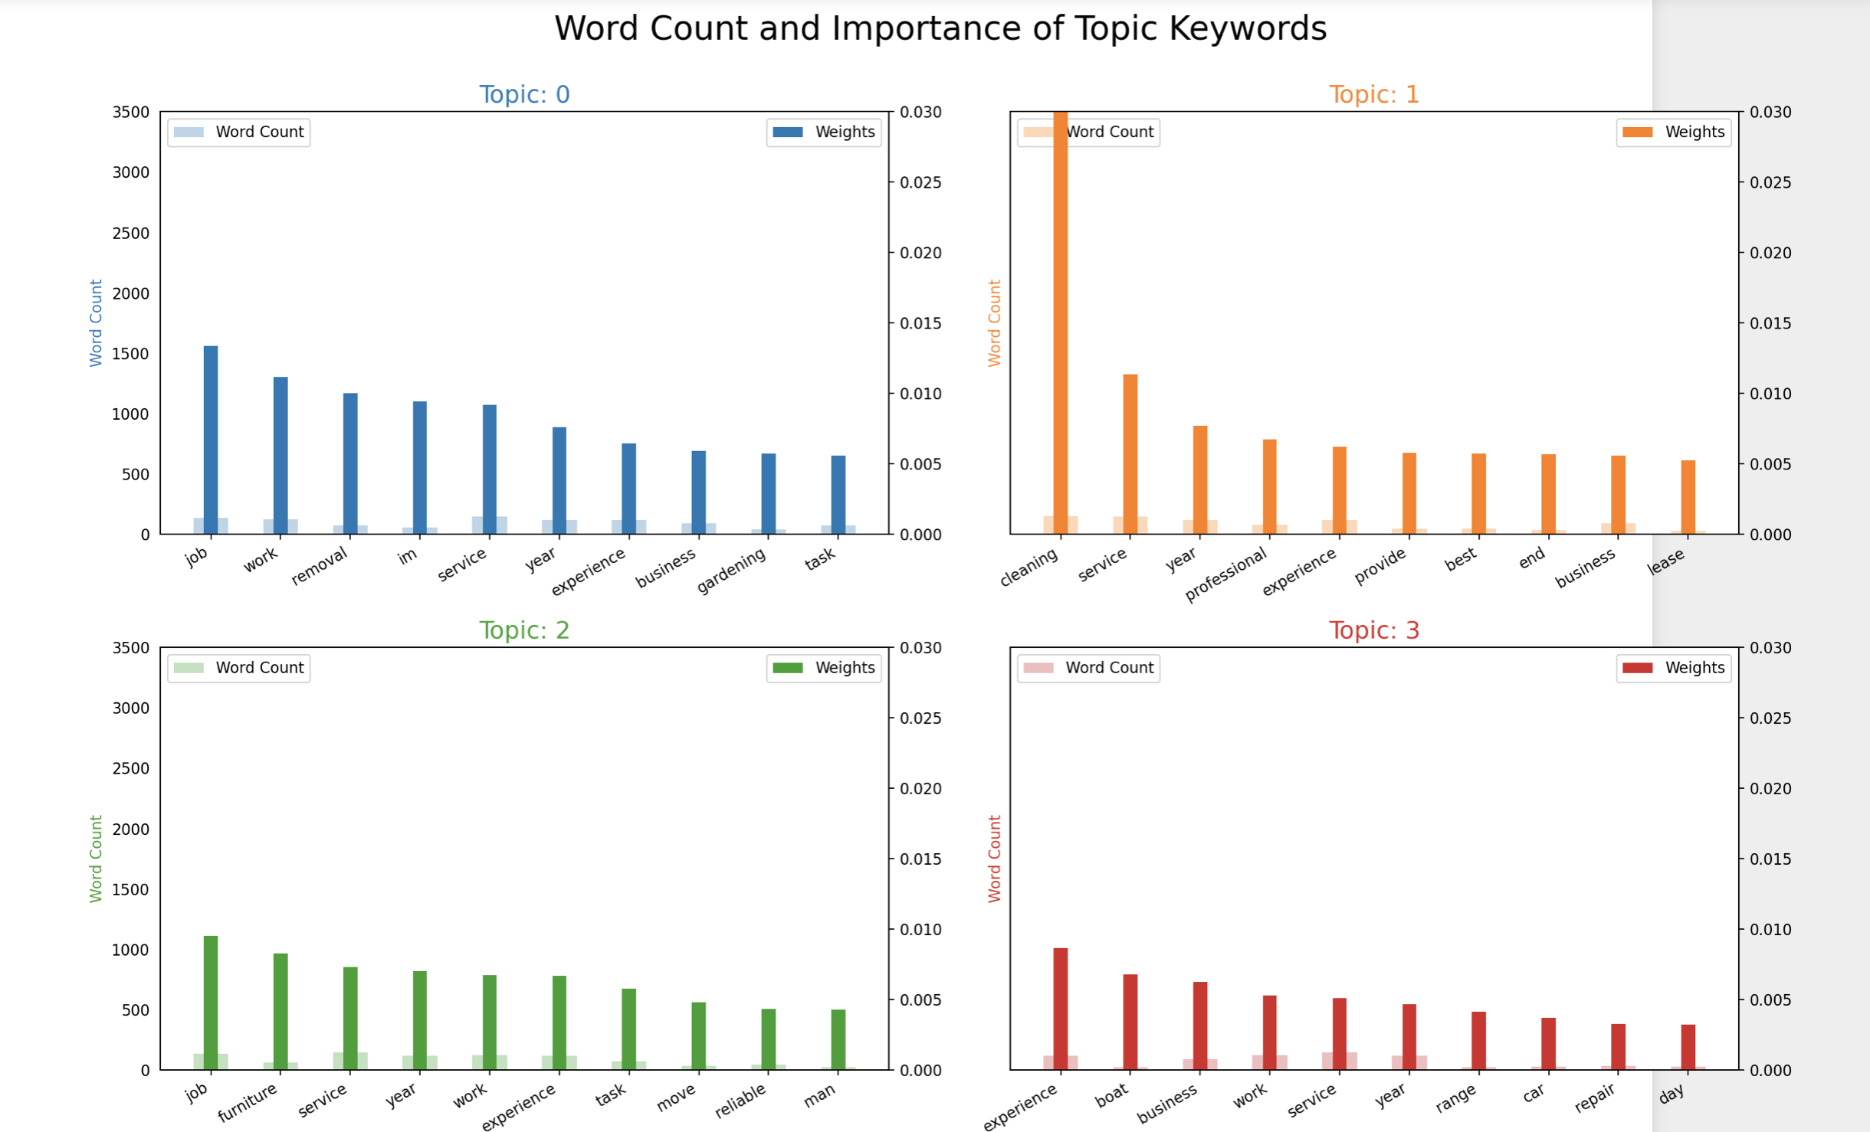
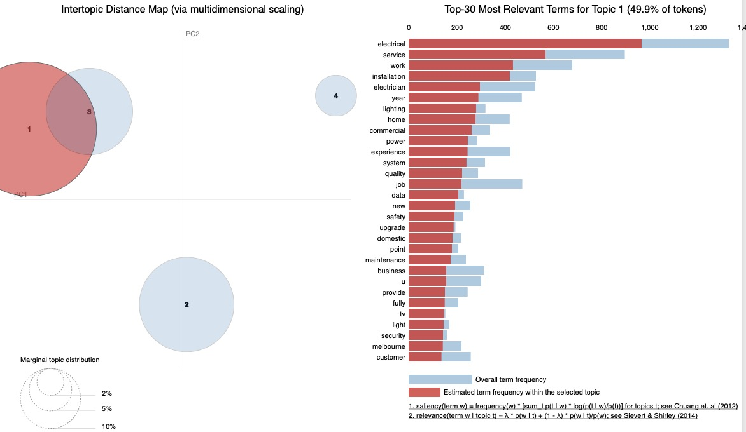
Results - Visualization for LDA model (for all electricians)

Slide 22
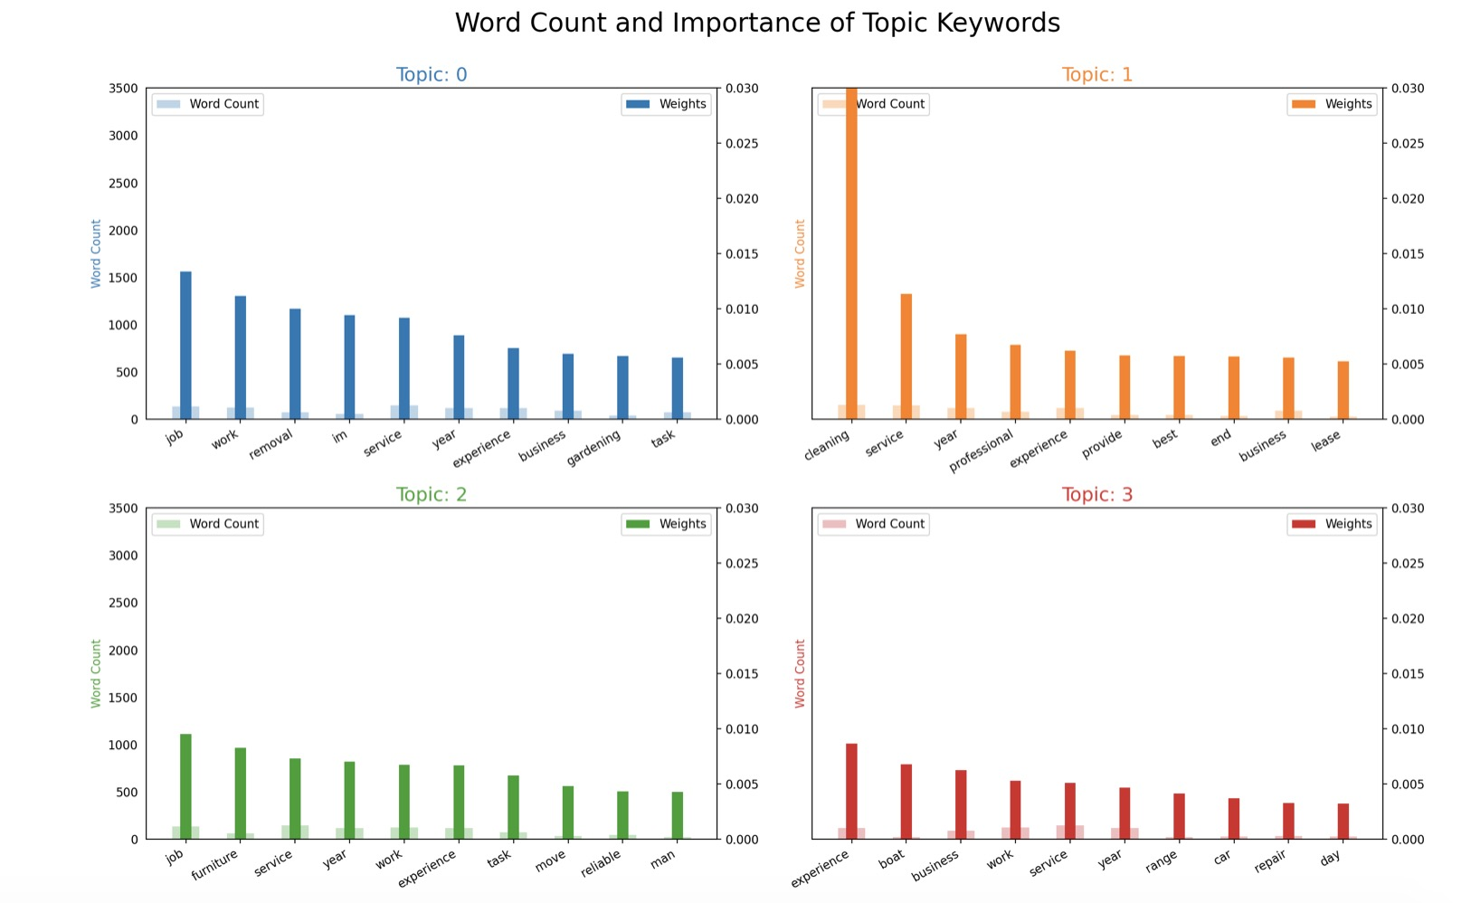
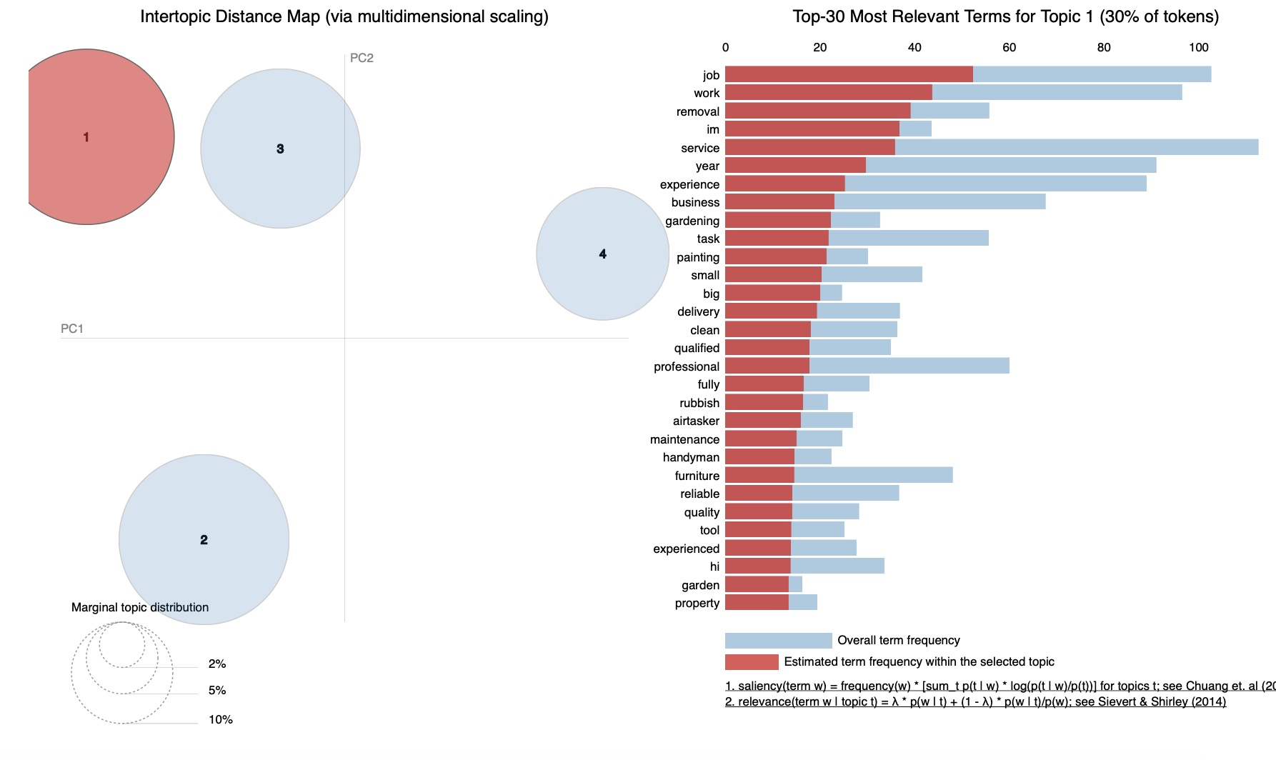
Results - Visualization for LDA model (for non-electrician's)

Slide 23
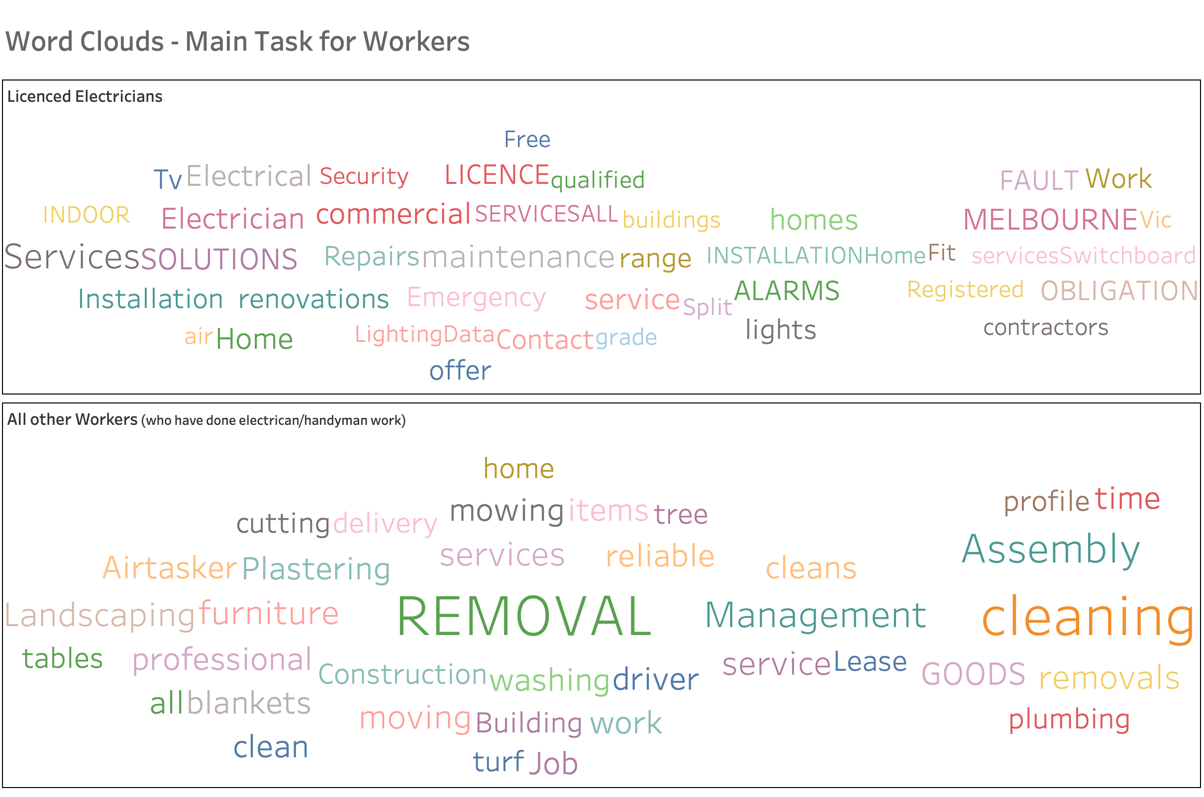
Word Clouds

Slide 24
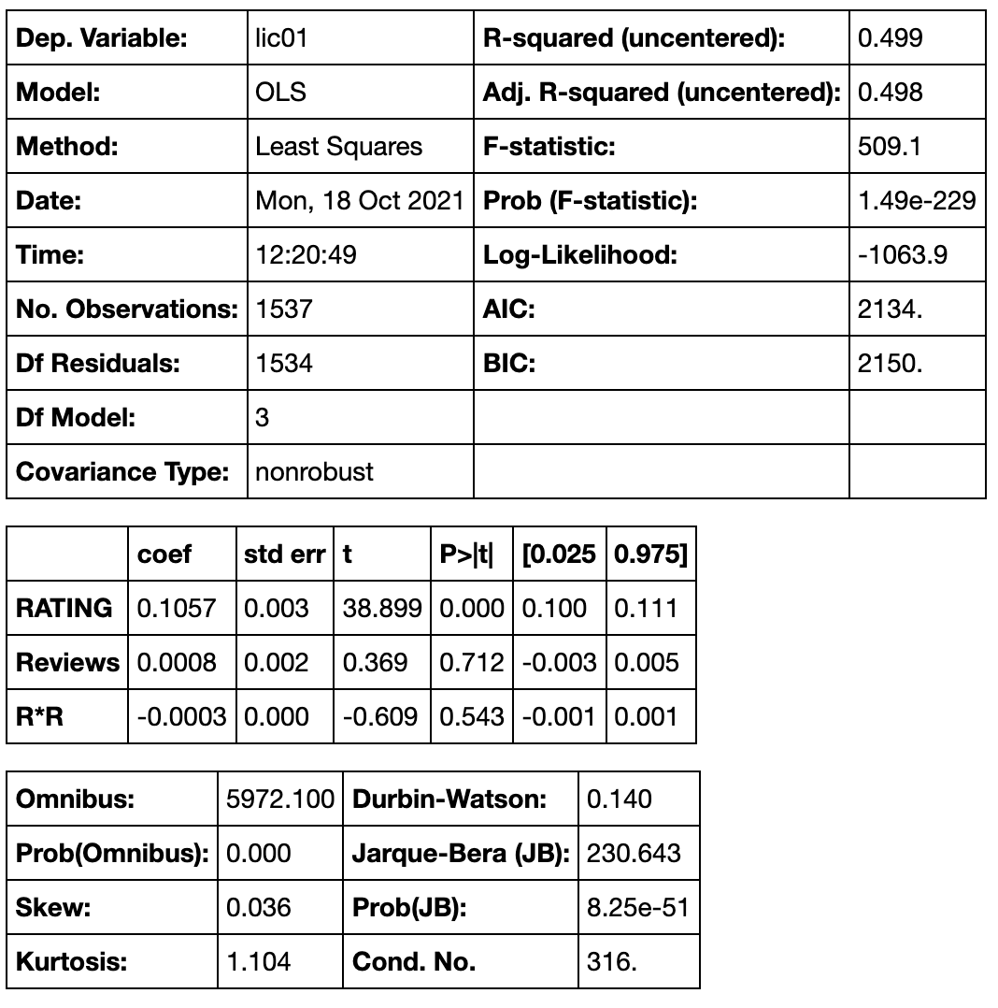
Correlations between the Licence status with the Ratings and Reviews
p-value of the rating is 0, we can reject the null hypothesis. license is linearly related with the rating, i.e., licensed workers are highly rated.
p-value of the reviews and the product of reviews and rating are higher, we accept the null hypothesis, i.e., license does not linearly depend on the number of provided Reviews.

Slide 25
Data Science Challenges ?
Data Preparation
Multiple Data Sources
Data Security
Understanding The Business Problem
Collaboration With Data Engineers

Slide 26
Conclusion
475 electricians are licensed but do not have a license number explicitly present. These can be promoted through ESV to update their license details.
The Metropolitain region always has the most electricians in Victoria. There are no active western Victoria workers in both Airtasker and ServiceSeeking. In the contract, the eastern population map in the Gumtree is empty. Comparing them, Hipage's workers are more evenly distributed.
Removal and cleaning are the popular jobs among non-electricians doing simple handyman work.
People do not really care about license status; they just see ratings and reviews to select the tasker for their job.
Airtasker has more unlicensed workers compared to the other online working platform, ESV should focus more on Airtasker.

Slide 27
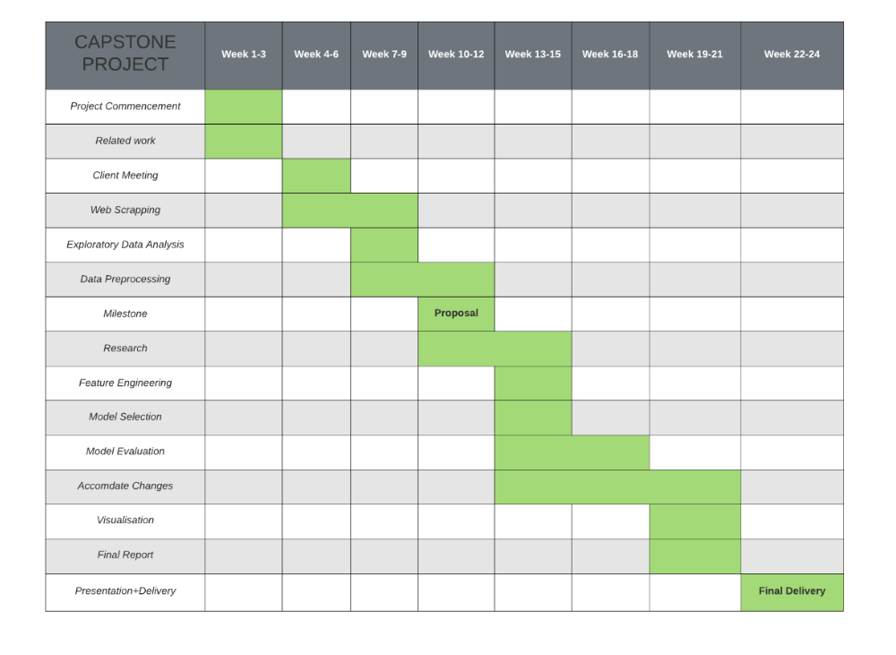
Timeline of Project

Slide 28
Team Contribution
Team Member | Contribution
Chen Zhou | Task Analysis and Tableau Visualization
Meghna Panda | Worker Scrapping, Data Processing and Tableau Visualization
Vignesh Lakshminarayanan | Team Lead, Topic Modelling
Xinyu Mao | Worker and Task Crawling, Tableau Visualization

Slide 29


Thank You.

